Slide 1
Twitter Crawling and Sentiment Analysis
Whani Kim
Human Factors Psychology Lab

Slide 2
Files included in folder
Collector.py – 트위터 데이터를 쉽게 가져올 수 있게끔 만든 파일
Tweet_collect.ipynb – Collector.py를 활용하는 파일
Twitter_Crawling_Lab – GetOldTweets을 활용한 트위터 크롤링
Sentiment_Aladdin – ＂알라딘” 키워드를 포함한 트윗의 감정분석
외
Doc2vec_run.py
Doc2vec_train.py
Doc2vec_test.py
Doc2vec.model
Finalized_model.sav

Slide 3
Twitter Crawling: GetOldTweets3
https://pypi.org/project/GetOldTweets3/
Provides tweets older than a week (which Twitter API doesn’t allow)
Only works on Python 3

Slide 4
GetOldTweets3
TwitterCriteria: A collection of search parameters to be used together with TweetManager.
setUsername (str or iterable): An optional specific username(s) from a twitter account (with or without "@").
setSince (str. "yyyy-mm-dd"): A lower bound date (UTC) to restrict search.
setUntil (str. "yyyy-mm-dd"): An upper bound date (not included) to restrict search.
setQuerySearch (str): A query text to be matched.
setTopTweets (bool): If True only the Top Tweets will be retrieved.
setNear(str): A reference location area from where tweets were generated.
setWithin (str): A distance radius from "near" location (e.g. 15mi).
setMaxTweets (int): The maximum number of tweets to be retrieved. If this number is unsetted or lower than 1 all possible tweets will be retrieved.

Slide 5
Sentiment Analysis
Source: https://github.com/hoho0443/classify_comment_emotion
데이터셋: Naver sentiment movie corpus
총 20만개 리뷰
Training Set: 150,000
Testing set: 50, 000

Slide 6
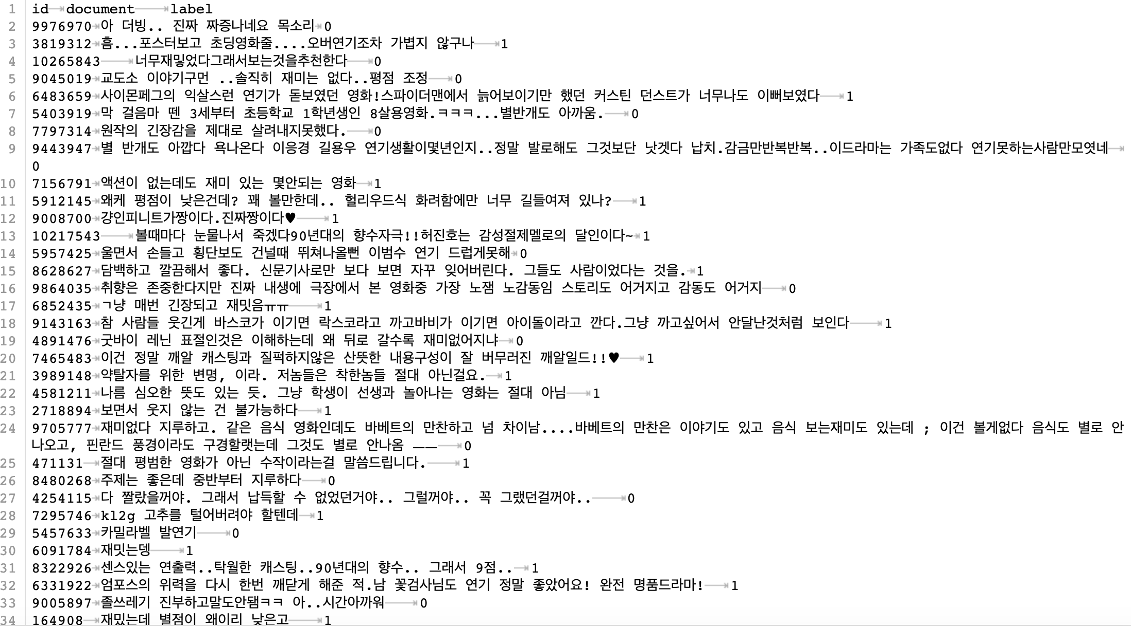
Training set

Slide 7
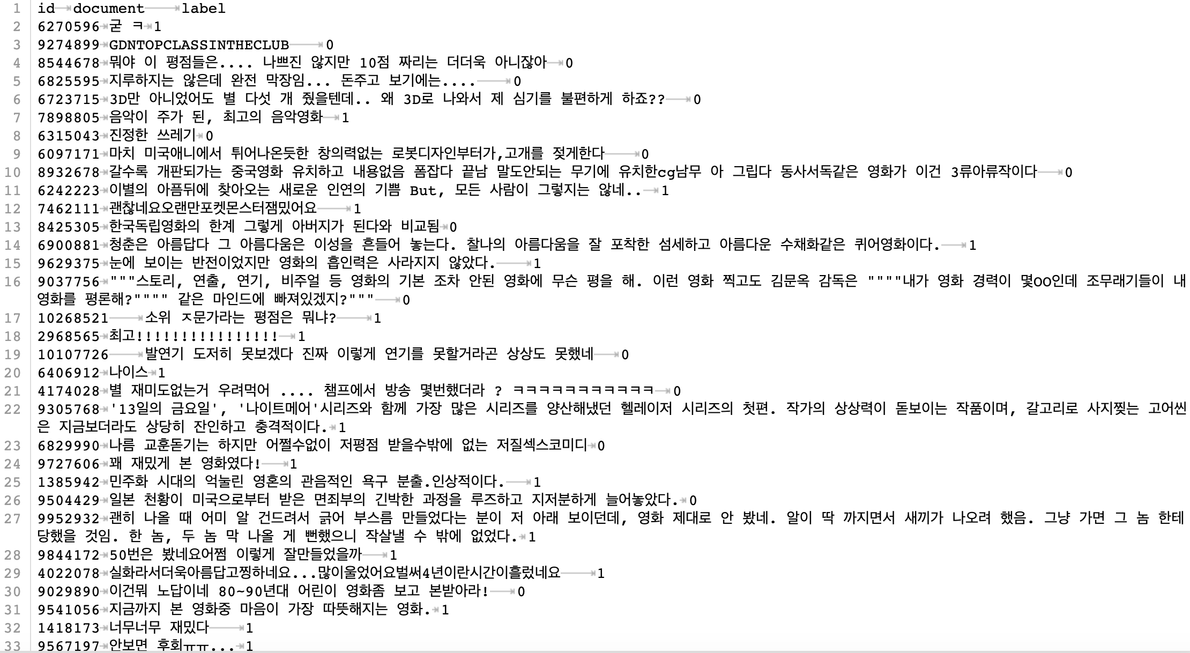
Testing Set

